Slide 1
A Geographic Analysis of Home Values, School Performance, and Crime in San Jose.
Allen Partlow
Heath Pope
Becca Wolber
Sharath Ram Srinivasan

Slide 2
Objective: To investigate the relationship of Changes in Home Values, with School Performance and Crime in the South Bay.
This topic was interesting to us because as Bay Area residents, we want to know where is a good place to put down roots based on current trends.

Slide 3
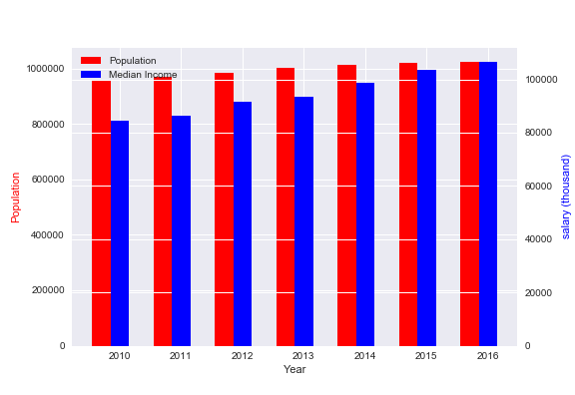
Why San Jose?
With a population of over a million and a median income of about $100,000, San Jose is the 10th largest city in the United States.
Yearly increase in home value in the Silicon Valley is double that of the US average, with the median Silicon Valley home costing 3.4x that of the median US home and nearly twice that of the California median home price.
We chose to narrow it down because it is difficult (expensive) to get data for multiple areas.

Slide 4
Source List
Census data for population and income information (2010-2016)
Census data for Zip Code Tabulated Areas (gmaps).
Great Schools API
Socrata Crime API
Zillow (National Home Price By Zip in .CSV)
California Department of Education Records

Slide 5
Parsing The Data
Greatschools API output is in an XML format:
We used Austin Taylor’s XML to Pandas DataFrame converter to transfer information from API calls through to an easily visualizable data frame format.
All columns were transferred as object values, and were converted to numerics as needed (latitude, longitude, magnitudes and rankings)
California Department of Education Records had some fields missing:
Dataset was curated through a series of excel functions before conversion into a dataframe and further manipulation with pandas
gmaps extension for jupyter notebook was used for geographic visualization
Zillow nationwide housing data by zip code downloaded as a csv file
Socrata json API was used for crime data collection
MyGeoData.cloud was used to transfer US Census Zip Code Shapefiles into GeoJSON.
https://mygeodata.cloud/

Slide 6
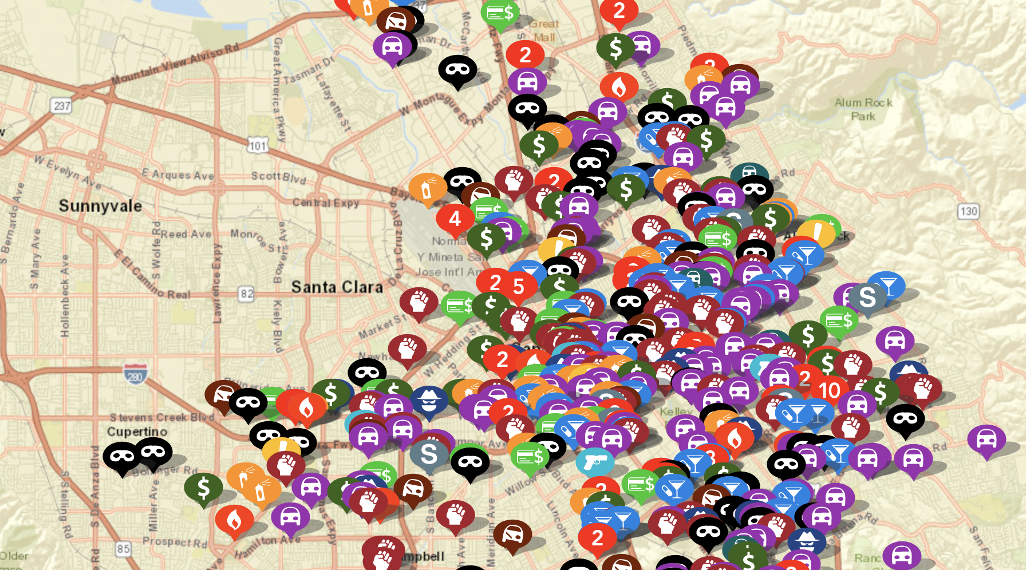
Parsing The Data (cont.)
Collecting crime data with geo-coordinates:
Websites like crimemapping.com and crimereports.com show crime types and locations updated on a daily basis. Accessing this data requires the permission of each participating agency. From crimereports.com: “Agencies have complete control over the frequency at which they keep their incident data up to date.”
Socrata aims to unleash the power of government
data to improve society. Socrata provides API
Endpoints that can call a list of 1000 dictionaries
describing crimes and locations from Santa Clara
County Sheriff.

Slide 7
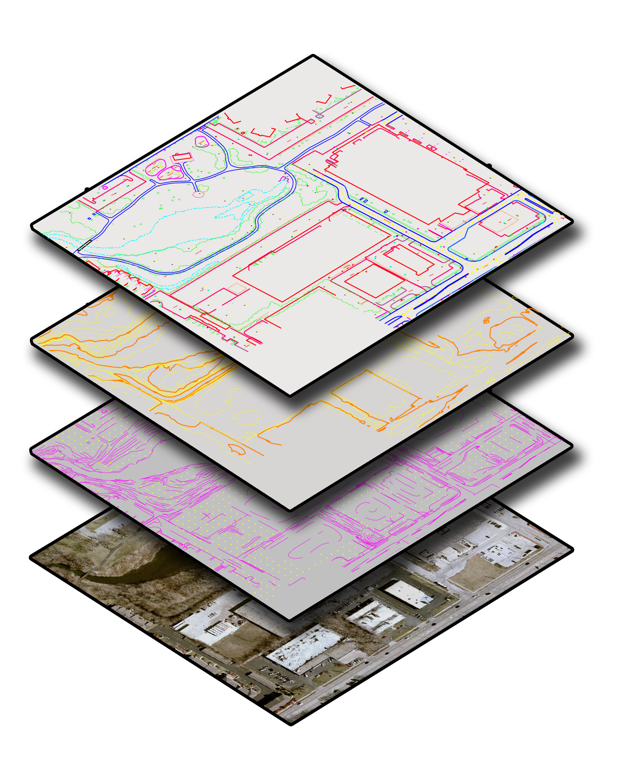
Analysis
After collecting and wrangling the datasets, we combined our data using Python and gmaps (a utility available for Jupyter Notebooks). This allowed us to map out our data geographically in layers so we could easily interpret trends.
Source of Image: https://aeromapping.files.wordpress.com/2015/04/panimetric-map-layers.png

Slide 8
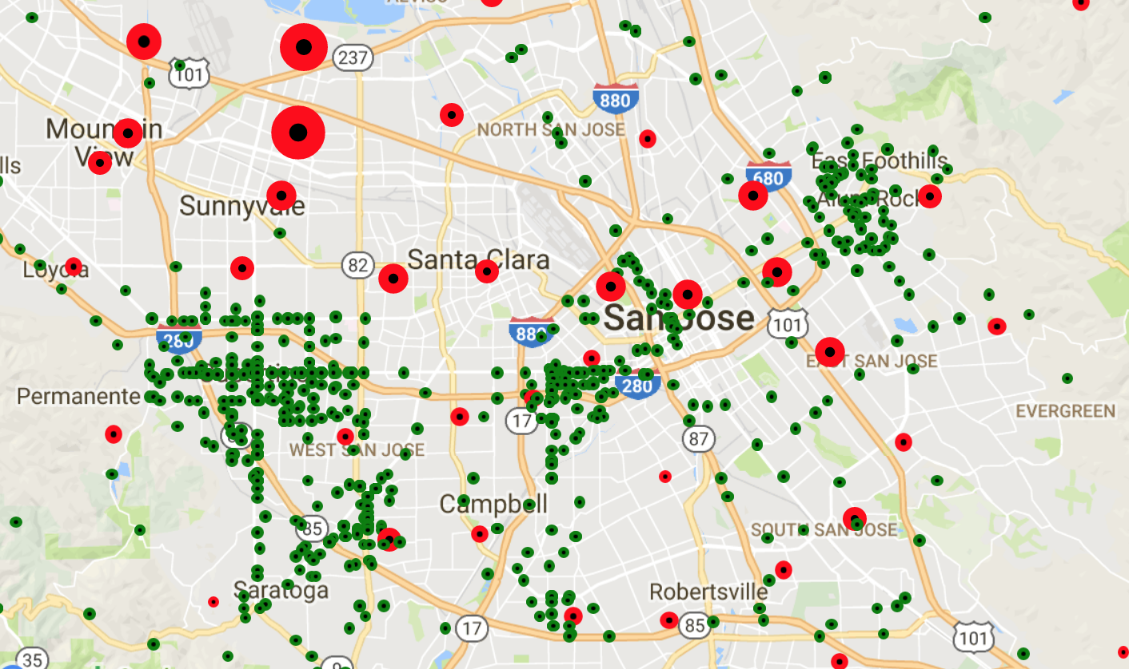
Home Value Appreciation vs. Crime
Pinpoints:
Red = Zip Home Value Appreciation (larger size = larger change in value)
Green = 2012 crime from Santa Clara County Sheriff

Slide 9
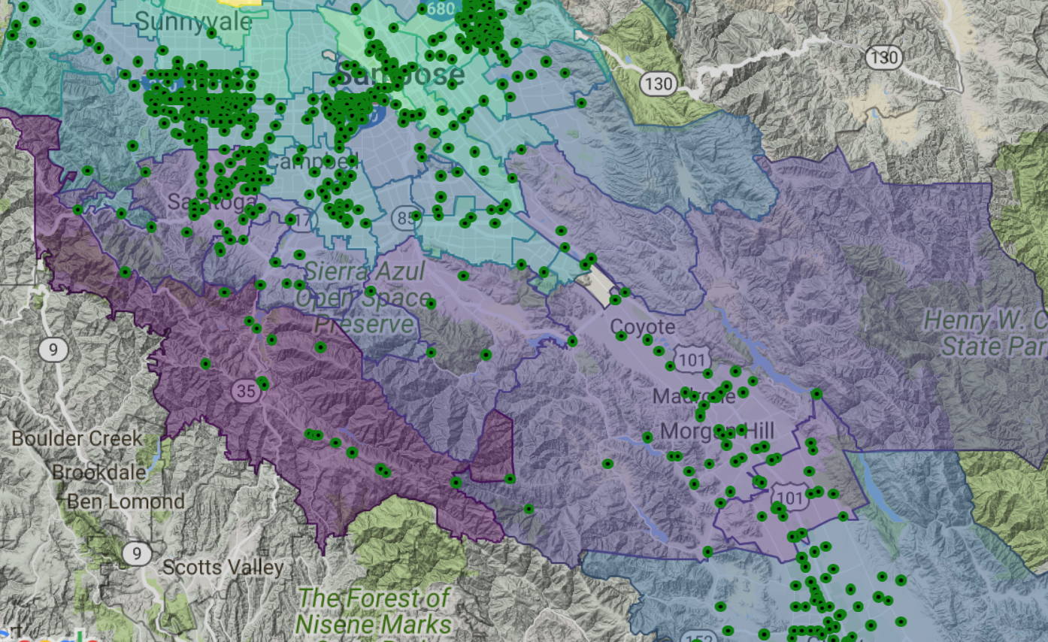
Home Value Appreciation vs. Crime: 2.0
Purple = Low Growth, Green = Moderate Growth, Yellow = High Growth
Green = 2012 crime data

Slide 10
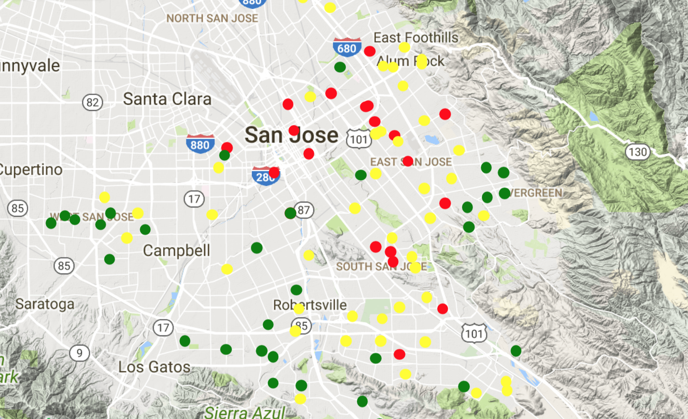
Distribution of Schools by Rating
Pinpoints:
Red = Lower School Rating
Yellow = Mid School Rating
Green = Higher School Rating

Slide 11
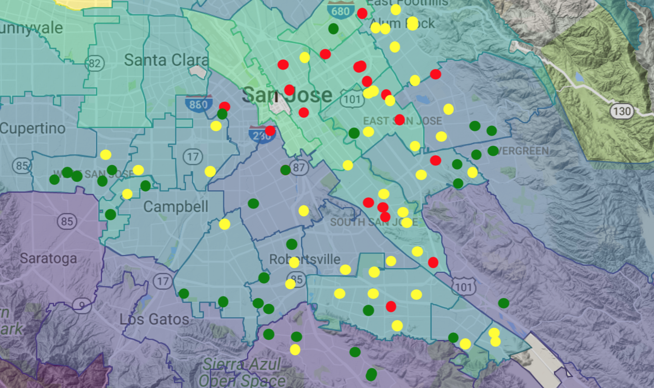
Home Value Growth vs School Ratings
Background:
Purple = Low Growth
Green = Moderate Growth
Yellow = High Growth
Pinpoints:
Red = Lower School Rating
Yellow = Mid School Rating
Green = Higher School Rating

Slide 12
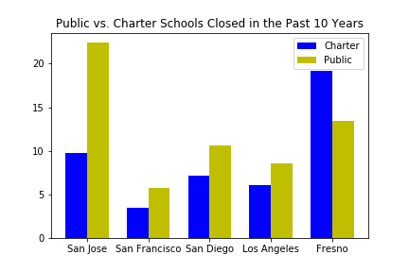
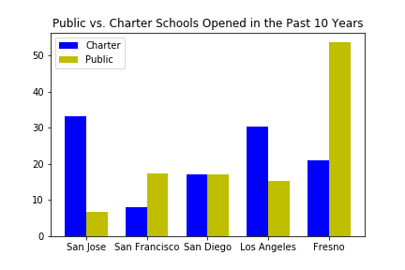
School Turnover
Top 5 CA Cities, schools per population in millions

Slide 13
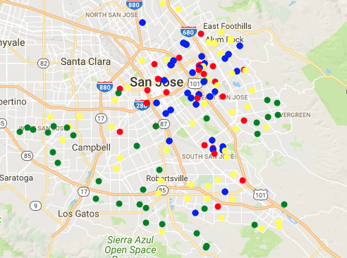
New Charter Schools May Offer Promise
Better schools distributed on outskirts of city, lower performing schools mostly distributed in the inner city, East San Jose
New charter schools that have yet to be ranked on greatschools are localized to underserved areas.
Red, yellow, green = all ranked schools ; blue = unranked new charter schools

Slide 14
Conclusions
Some counterintuitive trends have appeared:
Many areas serviced by poor schools are experiencing more rapid growth in home values.
San Jose has seen a notable shift from public to charter schools, with new charter schools opening mainly in underserved areas.
Areas with lower home appreciation tend to experience more crime incidents per Sheriff data.

Slide 15
Limitations to our data
While recruitment efforts and shortages are highly publicized, specific numbers on police turnover and personnel in the city of San Jose were not available to the public
Archival crime data for local PD reports were hidden behind a hefty paywall
Accessing crime data with geo-coordinates.
California’s standardized testing system switched within our the 5 year period of interest, leaving us without a standard metric by which to measure school success over time
School ratings were not available for all of the new charter schools opened within the past 10 years
Public datasets held multiple information gaps and required timely curation
Data is unavailable for many unincorporated regions within Santa Clara County

